Slide 1

Climate Change: An Analysis of CO₂ Emissions and Global Temperature Trends
Yugank Singh
yugank942@gmail.com]
8052128256
GITHUB

Slide 2
Project Files
Excel Dashboard: LINK
Note: For full interactivity, please download the file and open it in the Microsoft Excel desktop app. The web preview may not display correctly.
Interactive Power BI Dashboard: GITHUB LINK
Please Note: The Power BI project file (.pbix) is designed to be viewed in Microsoft Power BI Desktop.
To experience the full interactivity of the dashboard, including the DAX measures and custom visuals, please download the .pbix file from the repository and open it using the Power BI Desktop application.

Slide 3
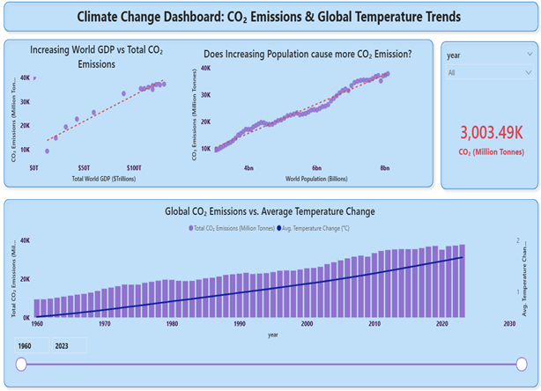
LINK TO .pbix FILE ON GIT HUB
POWER BI Dashboard

Slide 4
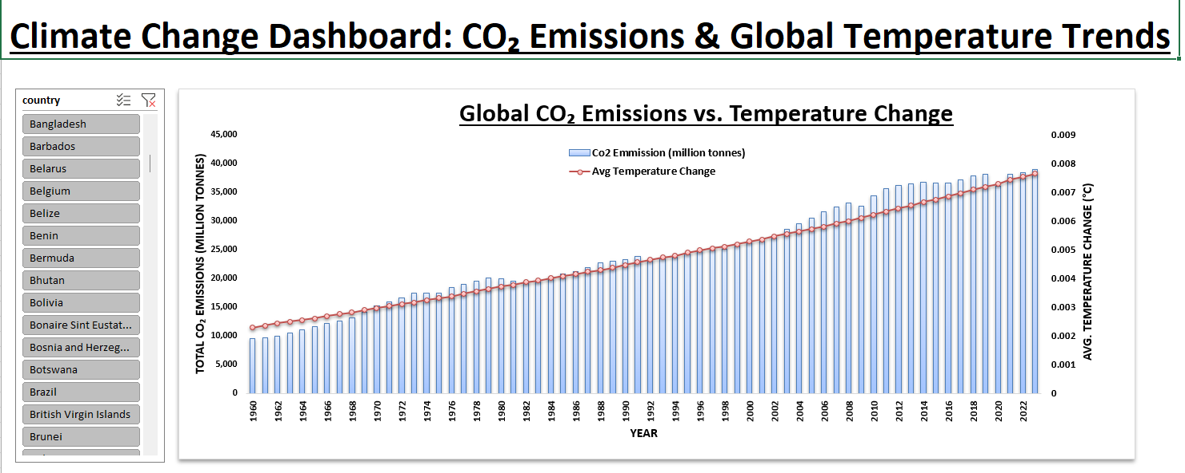
EXCEL WORKBOOK
FILE LINK
GIT HUB LINK

Slide 5
Project Workflow & Data Preparation (ETL)
Objective To analyze the relationship between global CO₂ emissions and temperature changes over the last 60+ years by creating two interactive dashboards in Excel and Power BI.
Data Source The dataset used was a comprehensive climate change dataset containing country-level and global data on greenhouse gas emissions, temperature anomalies, population, and GDP from 1960 to 2022.
ETL Workflow (in Power BI's Power Query) The raw dataset contained over 50,000 rows and 79 columns. The following steps were taken to clean and transform the data for analysis:
Column Selection: Reduced the dataset to 7 essential columns (country, year, iso_code, population, gdp, co2, temperature_change_from_ghg) for performance and focus.
Row Filtering: Filtered the data to only include years from 1960 onwards.
Handling Nulls: Removed rows with blank values in the core co2 and temperature_change_from_ghg columns to ensure data integrity.
Correcting Data Types: Manually corrected data types that were misinterpreted by Power BI, ensuring numerical data like temperature_change_from_ghg was accurately represented as a decimal number.

Slide 6

Power BI Dashboard & Key Insights
Key Metrics (DAX Measures) To enable dynamic filtering and analysis, the following core DAX measures were created:
Total CO2 = SUM(‘ClimateDate'[co2])
Average Temperature = AVERAGE(SUM(‘ClimateDate'[temperature_change_from_ghg])
Key Insights
Strong Positive Correlation: The primary combo chart clearly demonstrates a strong positive correlation between the rise in global CO₂ emissions (from ~9.4B tonnes in 1960 to ~37B tonnes in 2022) and the increase in average global temperature change (from ~0.35°C to over 1.2°C in the same period).
Economic Drivers: The scatter plots reveal a general trend where higher GDP and larger populations are associated with higher CO₂ emissions, highlighting the link between economic activity and environmental impact.
Interactive Exploration: The dashboard's slicers allow for dynamic exploration of the data by country and year, enabling a deeper understanding of climate trends.

Slide 7
Challenges & Future Extensions
Challenges Encountered
During the project, two key data-specific challenges were identified and overcome:
Data Type Correction: Power BI initially misinterpreted the temperature_change_from_ghg column as a whole number, causing all values to appear as '0'. This was resolved by removing the faulty automatic type-change step in Power Query and manually setting the correct "Decimal Number" format.
Data Structure Complexity: The country column contained both individual nations and a pre-aggregated "World" total. Including both in a single country-comparison chart would be misleading. I addressed this by focusing the main visuals on the global trend and using the "World" filter for the primary analysis, while still allowing for individual country exploration via the slicer.
Future Extensions The analysis can be extended in several ways:
Forecasting: Use Power BI’s built-in forecasting tools to project future CO₂ emissions and temperature trends based on historical data.
Per-Capita Analysis: Create additional DAX measures to analyze CO₂ emissions and GDP on a per-capita basis to normalize the data between countries of different sizes.
Incorporate More Variables: Integrate other relevant data, such as sea-level rise or renewable energy consumption, to create a more holistic view of climate change.

